Slide 1
程式設計實習(一)

Slide 2
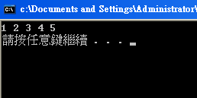
loop
for( int number = 1; number <= 5; number ++ )
cout << number << " ";
cout << endl;

Slide 3
loop
int number = 1;
while ( number <= 5 )
{
cout << number << " ";
number ++;
}
cout << endl;

Slide 4
loop
int number = 1;
do {
cout << number << " ";
number++;
} while ( number <= 5 );
cout << endl;

Slide 5
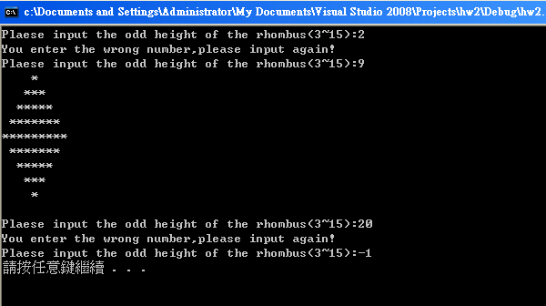
Hw 2

